Slide 2


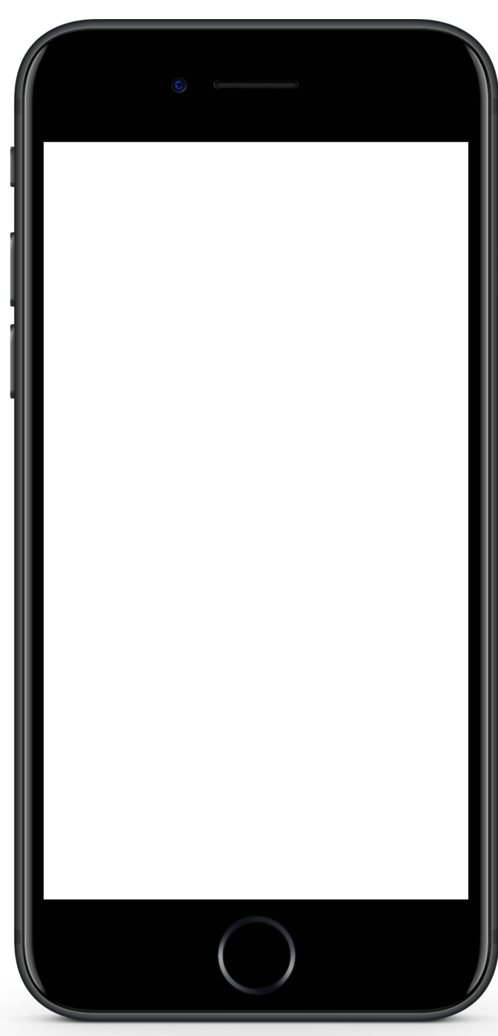

Mobile Application Development
Muhammad Ashraf Baloch

Slide 3

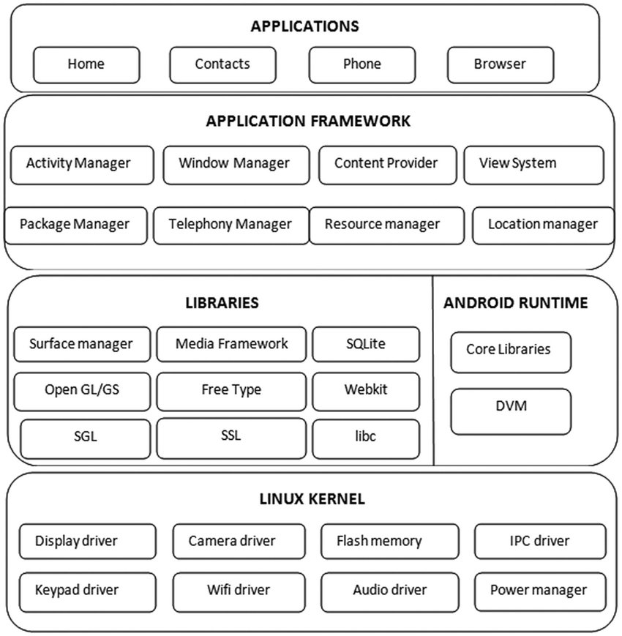

Slide 4

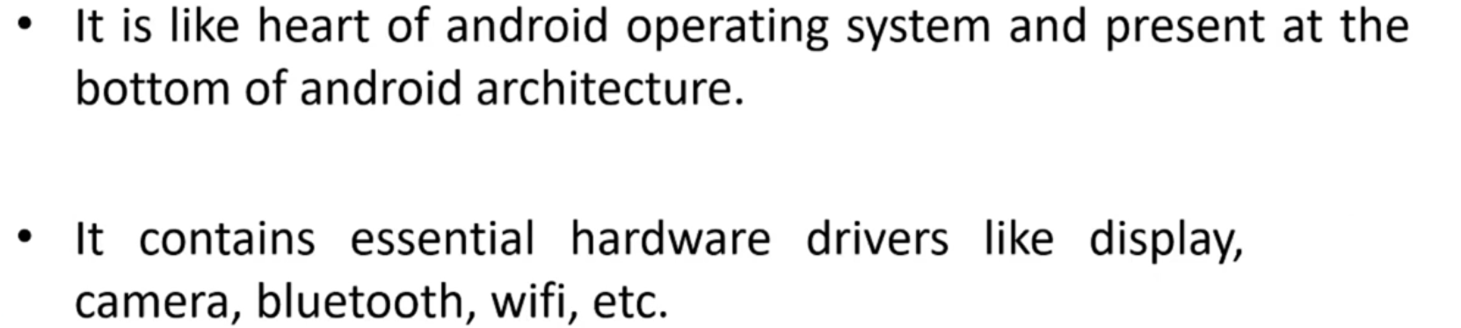
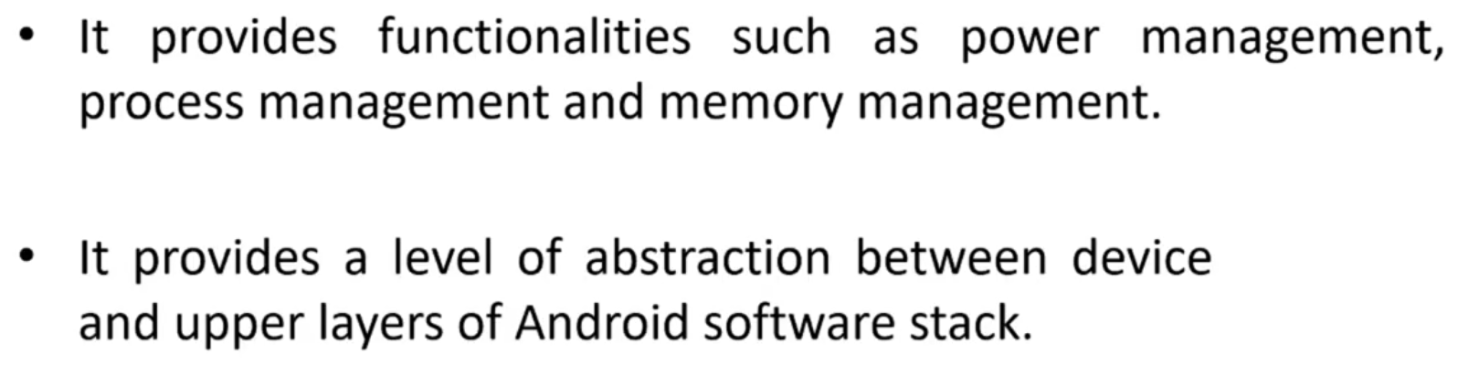
Audio
Hardware

Slide 5

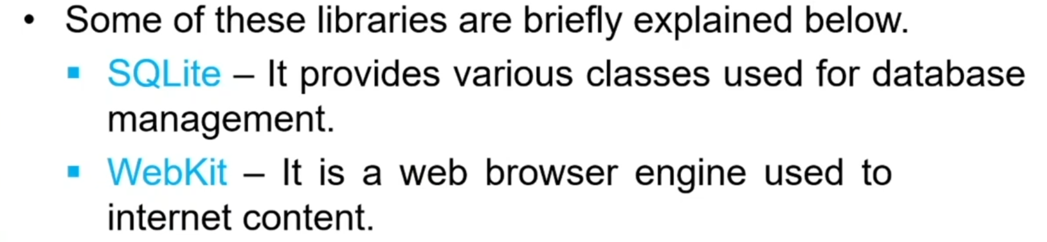
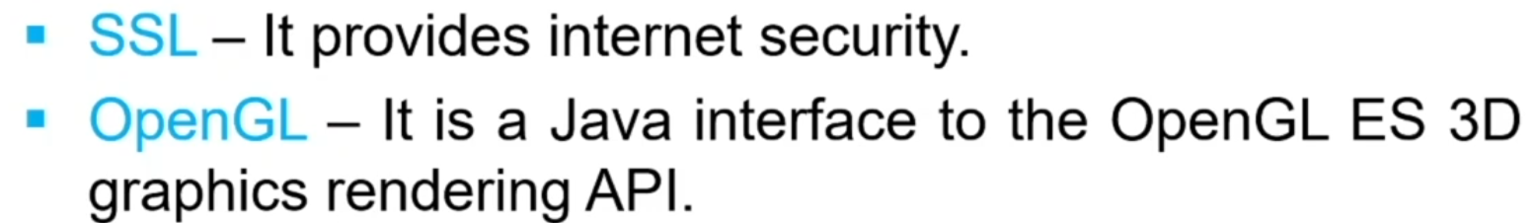
Display

Slide 6

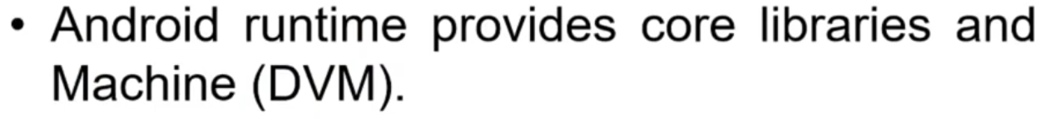
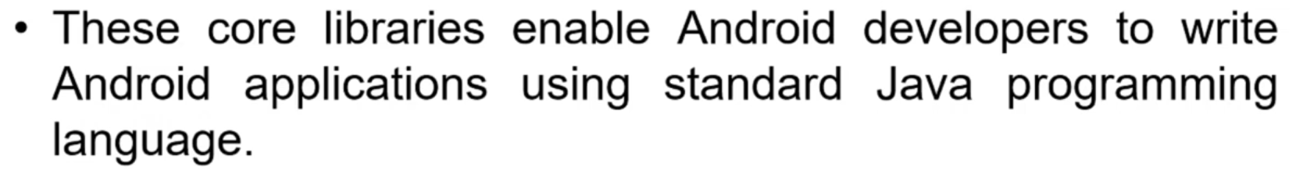
Dalvik Virtual Machine
The DVM is a virtual machine to run Android applications. The DVM executes Dalvik bytecode, which is compiled from programs written in the Java language. Note that the DVM is not a JVM. One of the key design principles of the DVM is that it should run on low memory mobile devices and loads quicker compared to any JVM

Slide 7


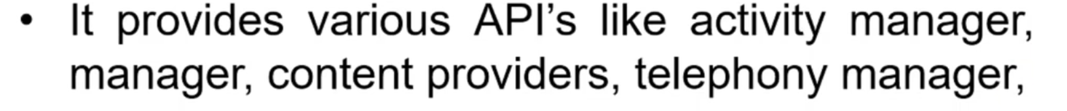
resource
ETC

Slide 8

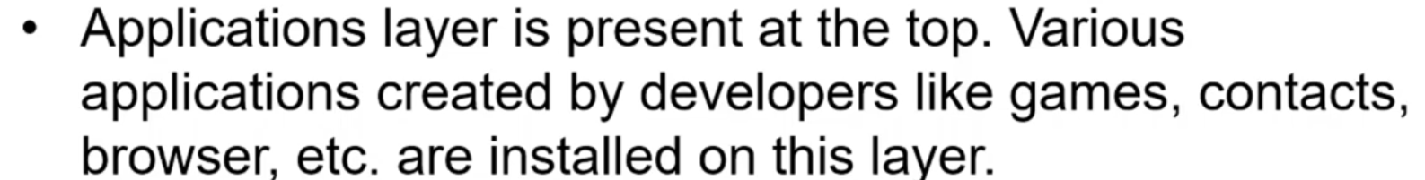

Slide 9
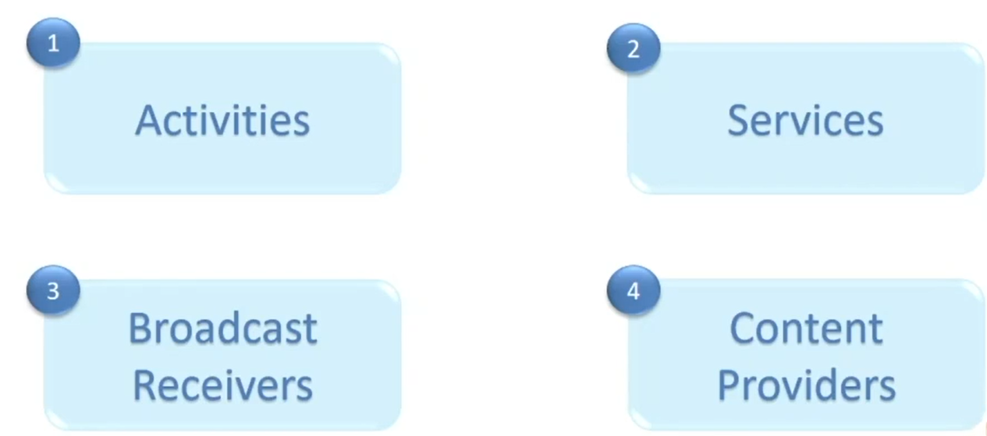
Android Application Components

Slide 10
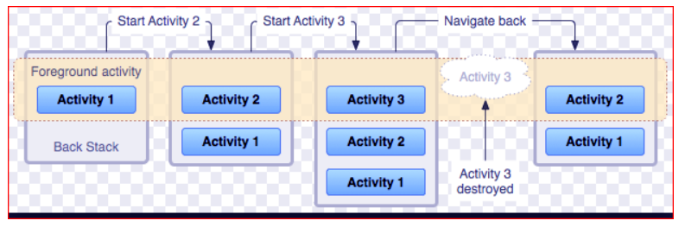
1. Activities
An activity represents a single screen with a user interface,in-short Activity performs actions on the screen. For example, an email application might have one activity that shows a list of new emails, another activity to compose an email, and another activity for reading emails. If an application has more than one activity, then one of them should be marked as the activity that is presented when the application is launched
public class MainActivity extends Activity {
//code
}

Slide 11
2. Services
A service is a component that runs in the background to perform long-running operations. For example, a service might play music in the background while the user is in a different application, or it might fetch data over the network without blocking user interaction with an activity.
A service is implemented as a subclass of Service class as follows −
public class MyService extends Service {
}

Slide 12
3. Broadcast Receivers
Broadcast Receiver is a component that responds to broadcast messages from another application or the same system. It can also deliver broadcasts to applications that are not running. For example – notify the user that the battery is low. Android developers can use broadcast messages in the application or outside the normal flow.
Broadcast Receivers simply respond to broadcast messages from other applications or from the system. For example, applications can also initiate broadcasts to let other applications know that some data has been downloaded to the device and is available for them to use, so this is broadcast receiver who will intercept this communication and will initiate appropriate action.
A broadcast receiver is implemented as a subclass of BroadcastReceiver class and each message is broadcaster as an Intent object.
public class MyReceiver extends BroadcastReceiver {
public void onReceive(context,intent){}
}

Slide 13
4. Content Providers
Content Provider is a component that allows applications to share data among multiple applications. It hides the details of the database and can be used to read and write private data of the application which is not shared. It would be a mess to access data from other applications without content providers.
For example – you can consider looking for contact details in contact list. Or You might want photos from the gallery which are also provided by Content Provider.
To implement this, extend ContentProvider in your subclass:
public class MyContentProvider extends ContentProvider {
public void onCreate(){}
}

Slide 14
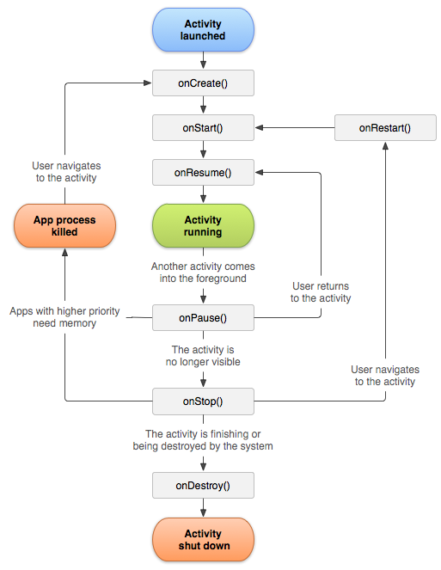
Android Activity Life cycle
Android Activity Lifecycle methods
Let's see the 7 lifecycle methods of android activity.
Method | Description
onCreate | called when activity is first created.
onStart | called when activity is becoming visible to the user.
onResume | called when activity will start interacting with the user.
onPause | called when activity is not visible to the user.
onStop | called when activity is no longer visible to the user.
onRestart | called after your activity is stopped, prior to start.
onDestroy | called before the activity is destroyed.

